Slide 1

SQL INJECTION
Ruben Sebastian Graneros Rojas
Felipe Galvao de Andrade Gomes

Slide 2

CONTENT SLIDE
Databases and their value
What is SQL?
SQLi vulnerabilities
Preventing SQLi
Types of SQL injection Attacks

Slide 3
SQL
What is SQL?
Anatomy of SQL Queries
SQL stands for Structured Query Language. It is a domain-specific language used for managing and manipulating relational databases. SQL provides a standardized way to interact with databases, allowing users to perform various tasks such as querying data, updating data, inserting data, and deleting data.
Querying: Retrieving data from one or more tables using SELECT statements.
Inserting: Adding new data into a database using INSERT statements.
Updating: Modifying existing data in a database using UPDATE statements.
Deleting: Removing data from a database using DELETE statements.
Creating: Creating new database objects such as tables, views, indexes, and procedures using CREATE statements.

Slide 4






Anatomy of SQL queries
SELECT “Clauses”
FROM
WHERE
This is where the develop specify which columns wants to retrieve from the database.
This is where you specify on which table or table want to retrieve the data
Filter statement
AND + OR
UPDATE
DROP
Conditional expressions used to filter the results with Boolean logic
Used to modify records in a table
Used to delete a table and all records

Slide 5
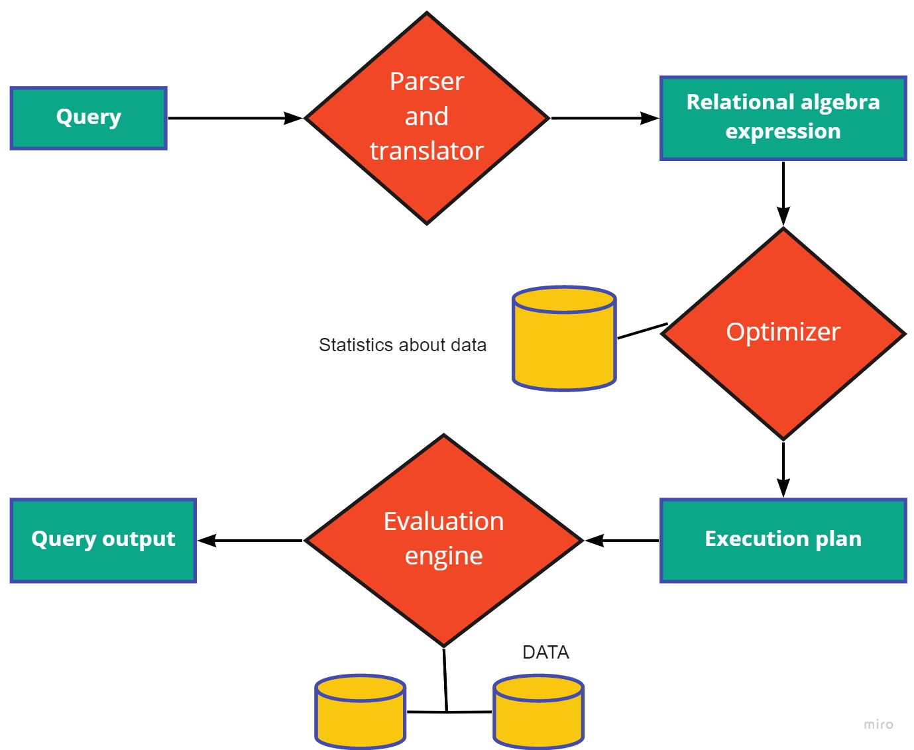
How Database Process Queries

Slide 6
What is SQL injection?
SQL injection is a type of cyberattack that targets web applications by exploiting vulnerabilities in the way they interact with databases.
The user input is placed as a puzzle piece in the query inside the source code, which allows an attacker to insert a different logic using SQL syntax to gain access to or manipulate sensitive data.

Slide 7
How SQL injection works
Input fields
Malicious Input
Vulnerabilities
Many web application take user input, such as search query, login credentials, or other form data, and use this input to construct SQL queries that interact with a database.
An attacker enters specially crafted input that includes SQL code.
If the web application does not properly validate, sanitize, or escape the input before using it in the SQL query.
Attack Scenarios
Prevention
-Unauthorized Data Access
-Unauthorized Data Access
-Bypassing Authentication
To prevent SQL Injection attacks, developers should use prepared statements or parameterized queries.

Slide 8
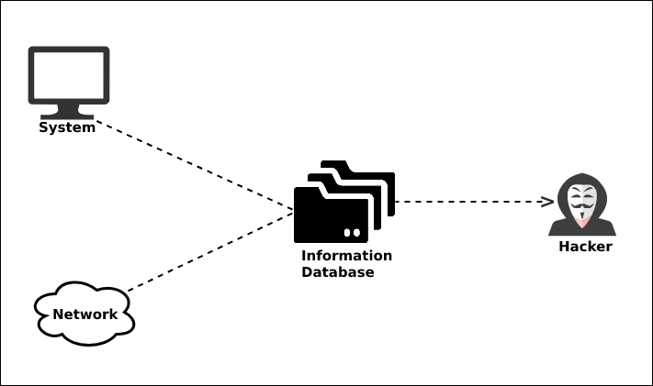
Consequences of the SQL injection attack
Data Manipulation
Unauthorized Data Access
Data Theft
Account Takeover
System Disruption
Backdoor Creation
Application Defacement
Application Defacement

Slide 9

Types of SQL injection attacks
Classic SQL Injection
Blind SQL Injection
Error-Based SQL Injection
In this type, attackers manipulate the application's input fields by injecting malicious SQL code.
In a blind SQL injection attack, attackers exploit vulnerabilities without directly seeing the database's responses.
Attackers intentionally trigger errors in the application's responses to gather information about the database structure or the data stored within it.
Union-Based SQL Injection
Out-of-Band SQL Injection
Compounded SQL Injection
Attackers use the UNION SQL operation to combine data from different database tables into the application's response.
This type of attack involves using different communication channels, such as DNS requests or HTTP requests, to retrieve data from the database.
In this type, multiple vulnerabilities are exploited in combination to achieve a more complex attack.

Slide 10
How to find out the Vulnerabilities
Manual
App’s
Code Review: Review your codebase line by line to identify security issues.
Penetration Testing (Pen Testing): Hire ethical hackers or security experts to perform penetration testing.
Automated Static Analysis Tools: Use automated static analysis tools that analyze your code without running it.
Dynamic Application Security Testing (DAST): DAST tools simulate attacks against your application to identify vulnerabilities in runtime.

Slide 11
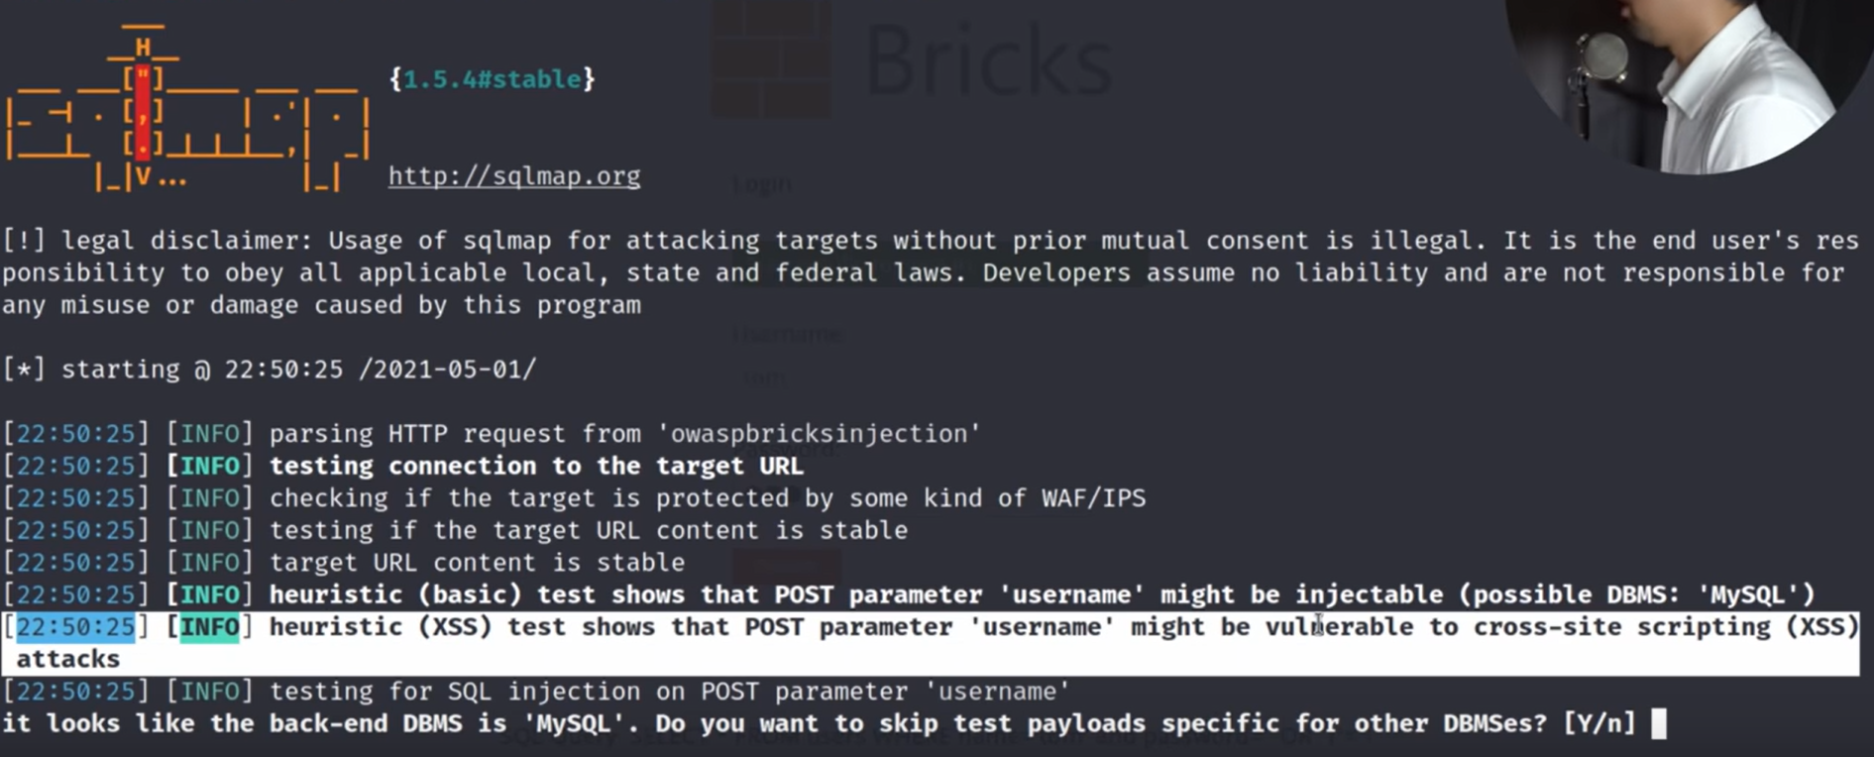
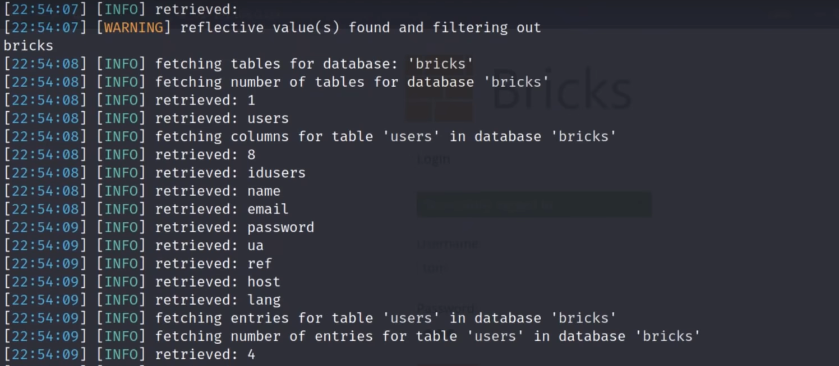
How to find out the Vulnerabilities

Slide 12
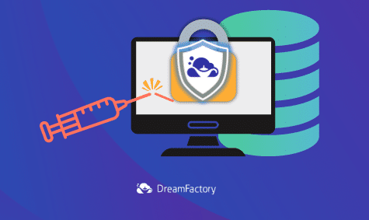
How to prevent
Use Parameterized Queries
Input Validation
Escaping User Input
Least Privilege Principle
Stored Procedures
Web Application Firewalls
Regular Updates and Patching

Slide 13
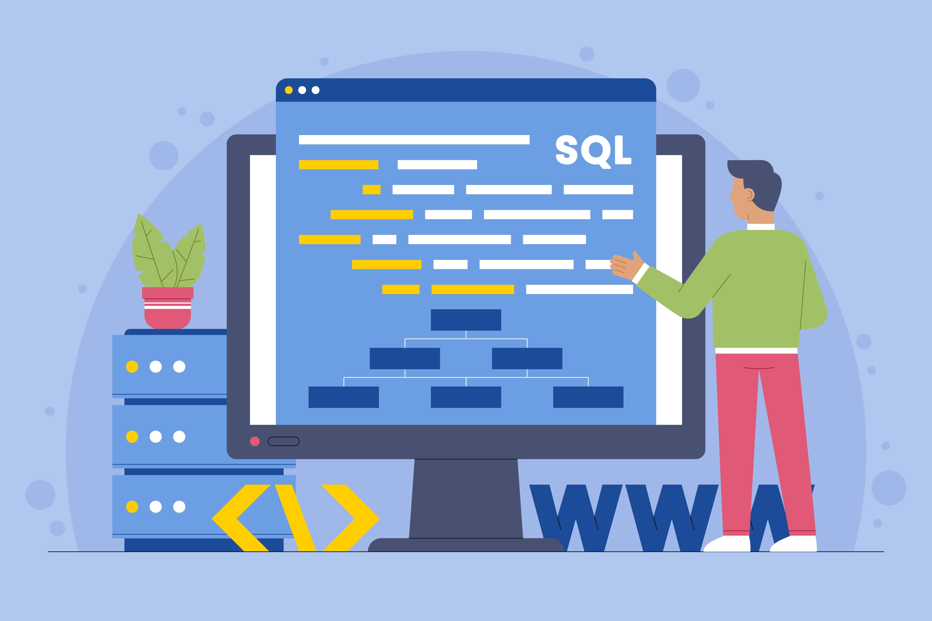
THANK YOU!

